Slide 1
Fundamentals of Programming
Lecture #2

Slide 2
Getting Familiar with the C++ Environment
Software Requirement
Opening an IDE
Creating new Project
Workspace and Projects manager
Changing Code Blocks Settings
Our First C++ Program

Slide 3
Software Requirement
A C++ Compiler
    GCC(MinGW) Compiler<=Preferred
    Microsoft Visual C++ 2010
    Borland C++ Compiler 5.82
An IDE
  Code Blocks<=Preferred
  Microsoft Visual C++ 2010 Express Studio
  Turbo C++

Slide 4
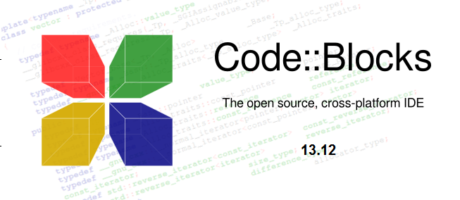
Opening an IDE
  IDE= Integrated Development Environment
    A set of programming tools for writing applications (source code editor, compiler, linker, debugger, etc.), all activated from a common user interface and menus.
  Open Code Blocks

Slide 5
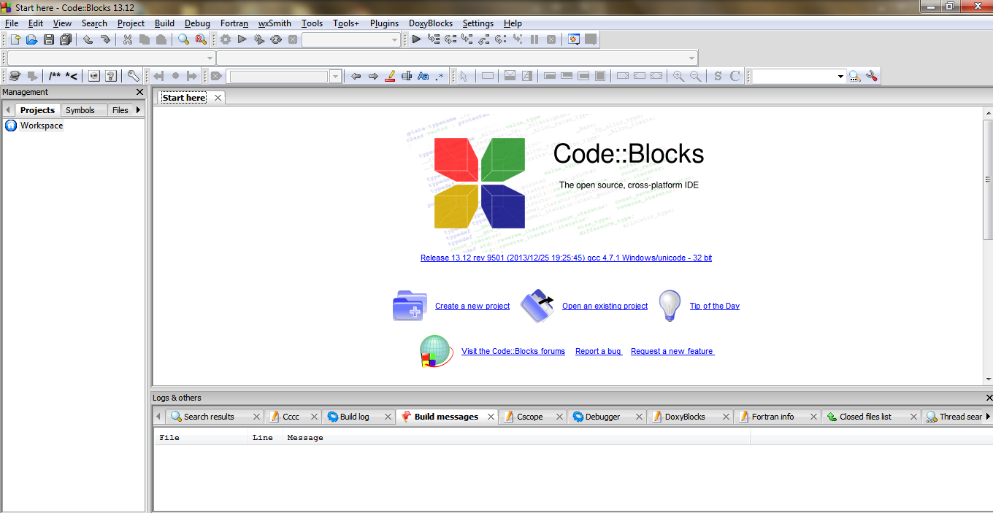
The Environment

Slide 6
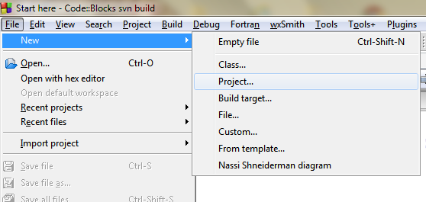
Create a new Project
An application is a runnable program. Most applications are built from multiple source files.
      Code::Blocks keep track of the files and compiler settings need to build an application with a project file

Slide 7
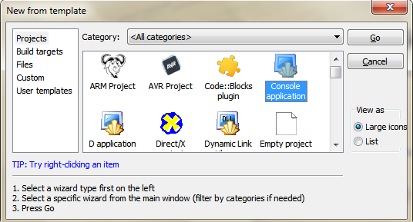
We use Console Applications
  An application that uses the command line for input and output rather than a graphical interface (GUI).

Slide 8
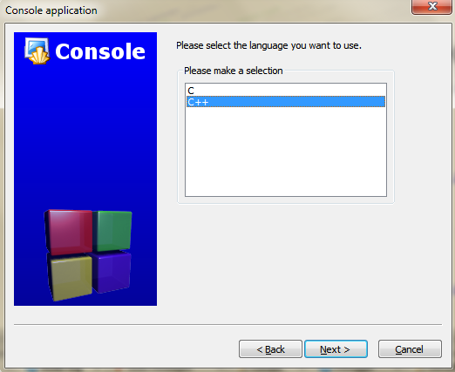
The Console Application Wizard

Slide 9
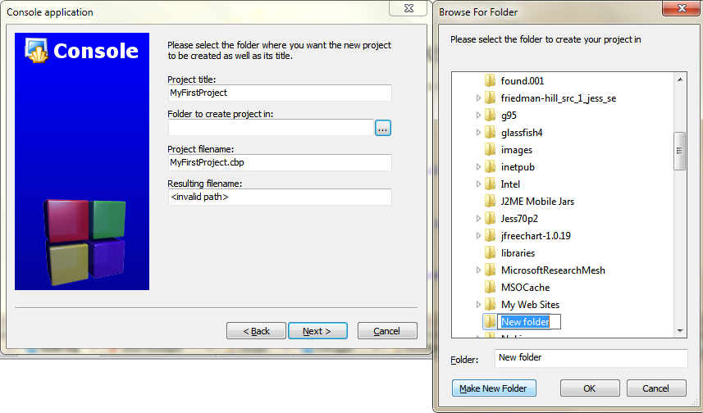
Project Properties
Give descriptive project title
Create a folder on c: drive(preferred) or use existing folder

Slide 10
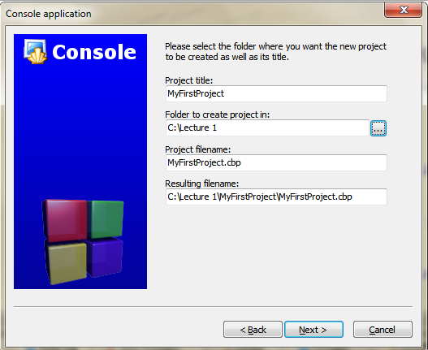
Project Properties
Cbp=Code Blocks Project

Slide 11
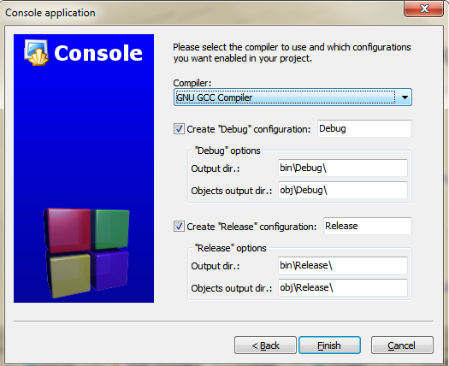
Select Compiler

Slide 12
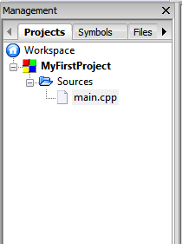
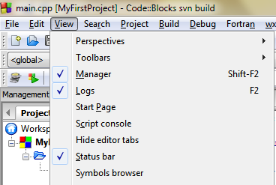
Workspace and Project Manager
Workspace collects projects together
    where you can easily switch between projects
The Projects are listed on the Manager
  One sample c++ source file is inserted
Can’t see Manager?
  make sure it is checked on the view menu

Slide 13
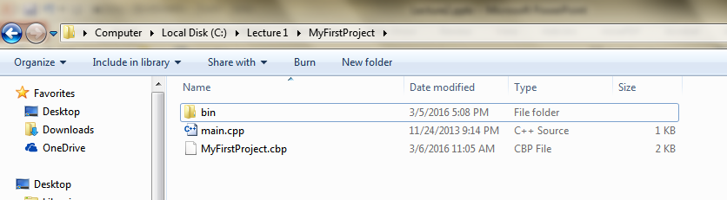
Windows Explorer
View your Project in Windows Explorer

Slide 14
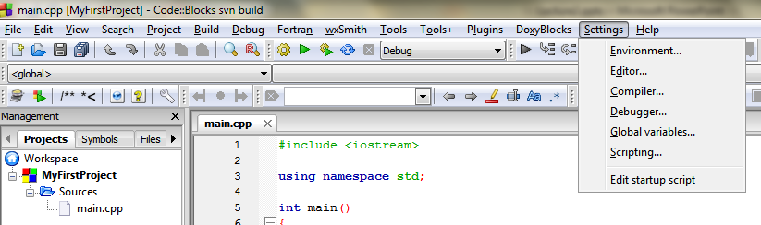
Settings
We can change settings as desired

Slide 15
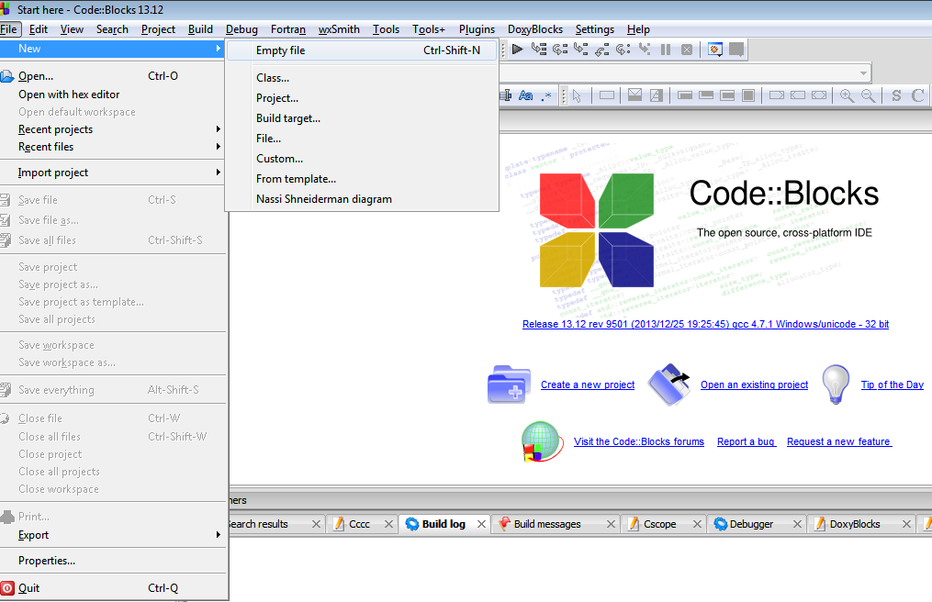
Empty Files
You can also create empty files

Slide 16
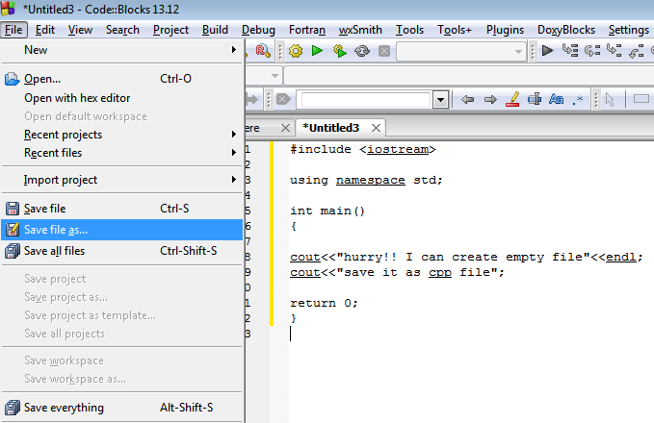
Then Save file

Slide 17
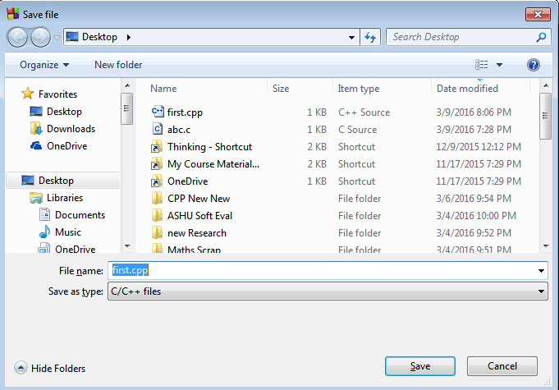
Empty Files
Save it as a C++ file

Slide 18

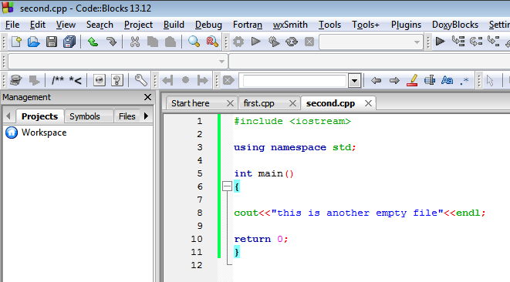

Empty Files
Then you can build and run as usual
You can create additional empty files and build, run

Slide 19
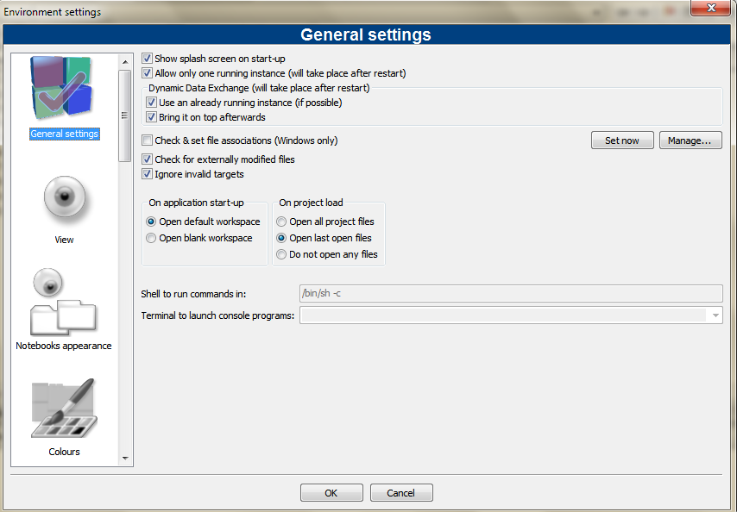
Environment Setting

Slide 20
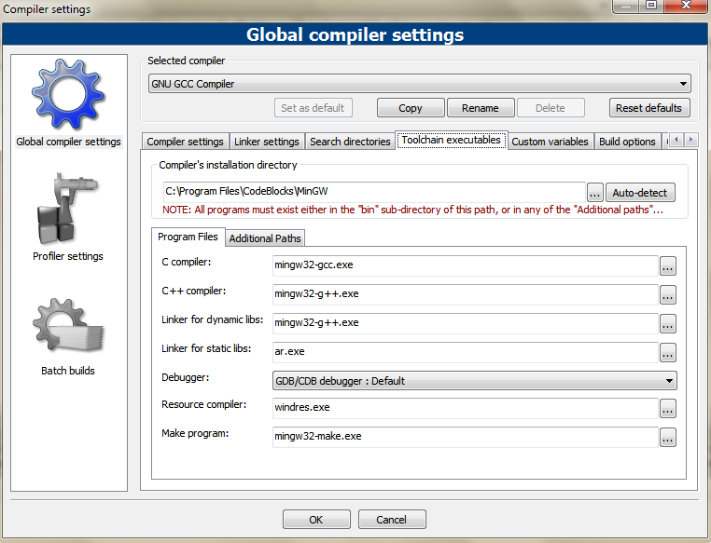
Compiler Settings
Don’t change this if you didn’t install additional compilers separately

Slide 21
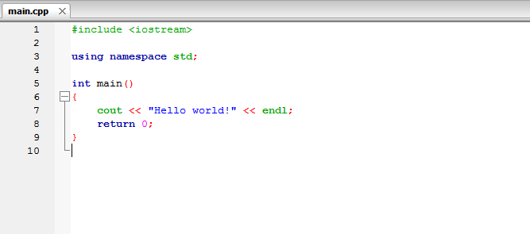
Our First C++ Program

Slide 22
Namespace and Libraries
A namespace is a collection of name definitions.
  One name, such as a function name, can be given different definitions in two namespaces.
  A program can then use one of these namespaces in one place and the other in another location.

Slide 23
Namespace and Libraries
All the standard libraries we will be using place their definitions in the std(standard) namespace.
  It is almost impossible to write a C++ program without using at least one of these libraries.
To use any of these definitions in your program, you must insert the following using directive:
  using namespace std;

Slide 24
Namespace and Libraries
For example, the library for console I/O is iostream. So, most of our demonstration programs will begin
#include <iostream>

Slide 25
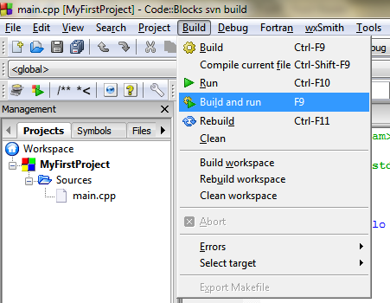
Build and Run
Build: The source program will be compiled and linker links the object files created by the compiler into an executable
Run: The program will be in memory

Slide 26
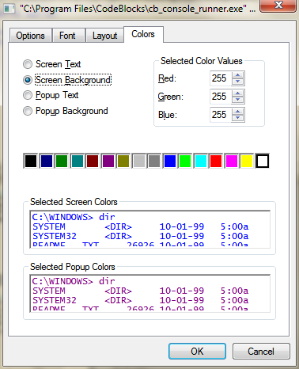
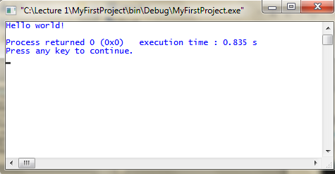
Console Screen
We can change the color and Font of the console
  Right click on the title bar
  Choose properties

